Slide 1
Simulation
examples

Slide 2
Example D Currency (exchange rate)
Stochastic Model

Slide 3
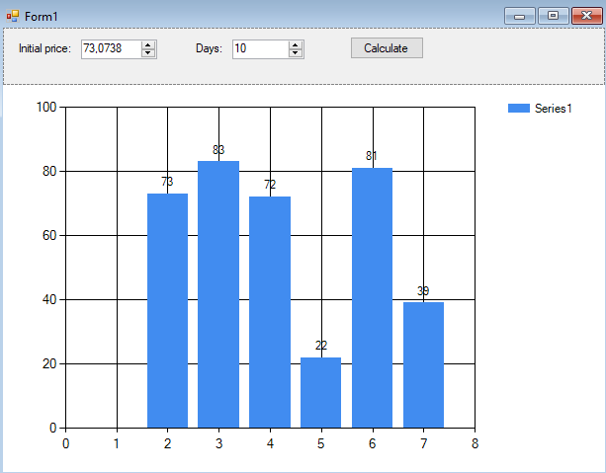
Example D Main window

Slide 4
Example D Business model
C = C * (1 + k*(random-0.5))

Slide 5
Example D Calculations
const double k = 0.02;
Random rnd = new Random();
private void btCalculate_Click(object sender, EventArgs e)
{
chart1.Series[0].Points.Clear();
double price = (double)inputPrice.Value;
int days = (int)inputDays.Value;
chart1.Series[0].Points.AddXY(0, price);
for (int i = 1; i <= days; i++)
{
price = price * (1 + k * (rnd.NextDouble() - 0.5));
chart1.Series[0].Points.AddXY(i, price);
}
}

Slide 6
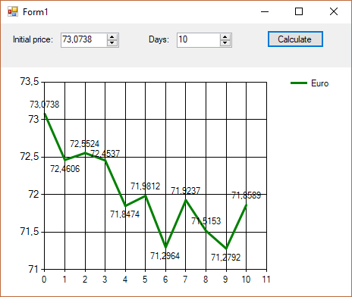
Example D Main window
CharAreas.YAxis.isStartedFromZero=false
Series -> BorderWidth, Color, IsValueShownAsLabel = true, LabelFormat = f4

Slide 7
Laboratory #4
Assignment:
Currency exchange game

